Slide 1
Recovery Scenario
Exception Handling
The Recovery Scenario Manager provides a wizard that guides you
through the process of defining a recovery scenario—a definition of an
unexpected event and the operation(s) necessary to recover the run
session. Recovery scenarios are saved in recovery scenario files.
A recovery scenario consists of the following:
Trigger Event—The event that interrupts your run session.
2. Recovery Operation The operation(s) that need to be performed in order to continue running the test or component.
For example, clicking an OK button in a pop-up window,
Post-Recovery Test Run Option—The instructions on how QuickTest should proceed once the recovery operations have been performed

Slide 2
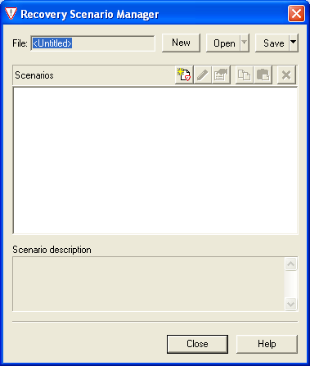
Creating a Recovery File
Exception Handling
To create a recovery file:
Choose Resources > Recovery Scenario Manager. The Recovery Scenario Manager dialog box opens.

Slide 3
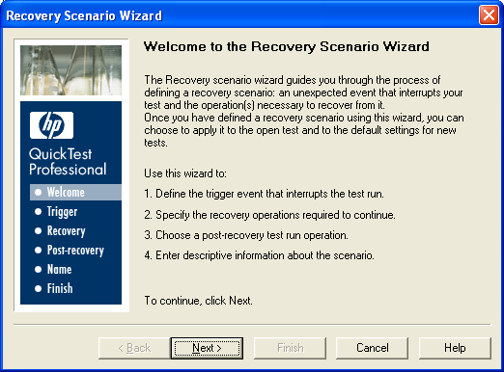
Creating a Recovery File
Exception Handling
Recovery Scenario Wizard screen provides general information about the
different options in the Recovery Scenario Wizard, and provides an
overview of the stages involved in defining a recovery scenario.

Slide 4
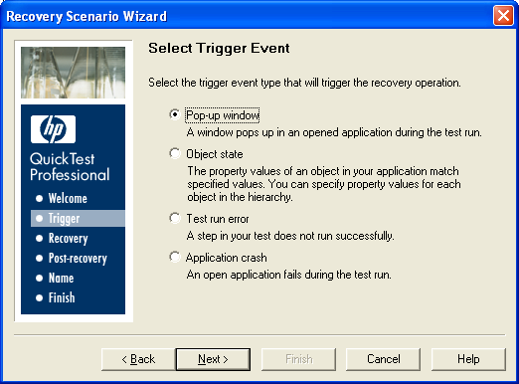
Creating a Recovery File
Exception Handling
The Select Trigger Event screen enables you to define the event type that
triggers the recovery scenario, and the way in which QuickTest recognizes
the event.
Select the trigger types :Pop-up window, Object state, Test run error,
Application crash

Slide 5
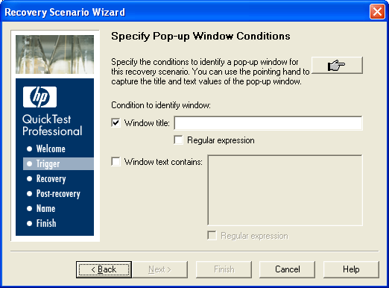
Creating a Recovery File
Exception Handling
Specify Pop-up Window Conditions Screen
Click the pointing hand and then click the pop-up window to capture
the window title

Slide 6
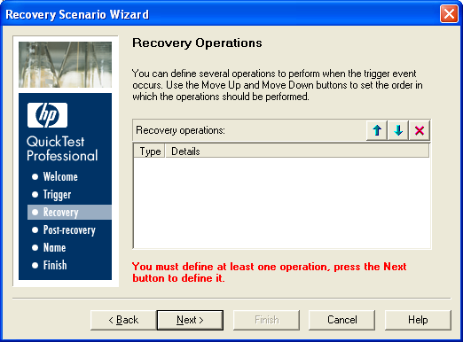
Creating a Recovery File
Exception Handling
Recovery operations are operations that QuickTest performs
sequentially when it recognizes the trigger event.

Slide 7
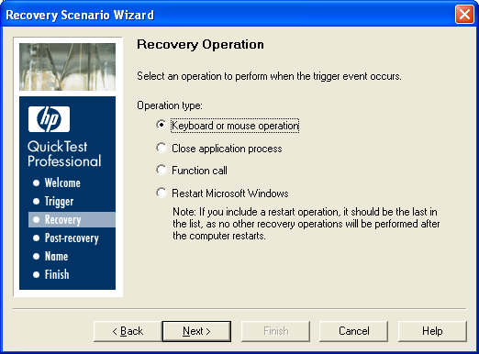
Creating a Recovery File
Exception Handling
Select a type of recovery operation and click Next. The next
screen displayed in the wizard depends on which recovery
operation type you select.

Slide 8
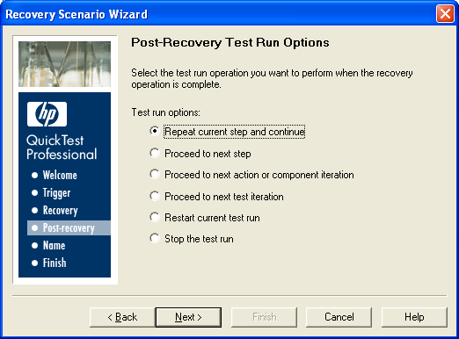
Creating a Recovery File
Exception Handling
Post-Recovery Test Run Options Screen
Post-recovery test run options specify how to continue the run session after QuickTest has identified the event and performed all of the specified recovery operations.

Slide 9
Usage of Recovery Scenario Manager
Exception Handling
The Recovery Scenario Manager enables you to manage existing
scenarios by:
        Viewing Recovery Scenario Properties
        Modifying Recovery Scenarios
        Deleting Recovery Scenarios
        Copying Recovery Scenarios between Recovery Scenario Files

Slide 10
Summary of the Topics Covered
Exception Handling
Recovery Scenario
Creating a Recovery File
Usage of Recovery Scenario Manager
Questions?

Slide 11

Thank You

